Slide 1

Frontend development
Two man group
-Isaac and Abbas-

Slide 2
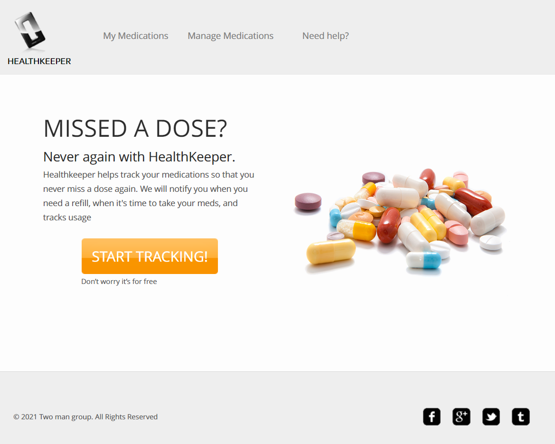
Index
This is the landing page of the website, it is purely advertorial with a start tracking button that will take you to the sign up page

Slide 3
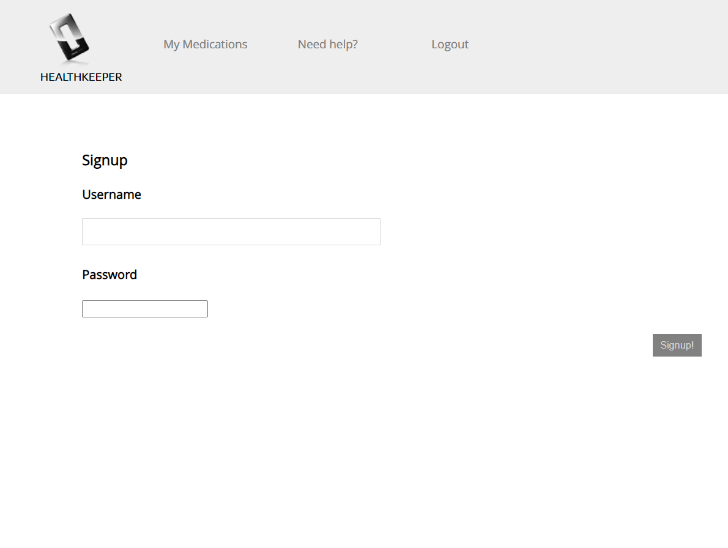
Sign-up
This page includes a text field for both a username and password to be created. It then submits that information and stores it on the server with the ‘Signup!’ button

Slide 4
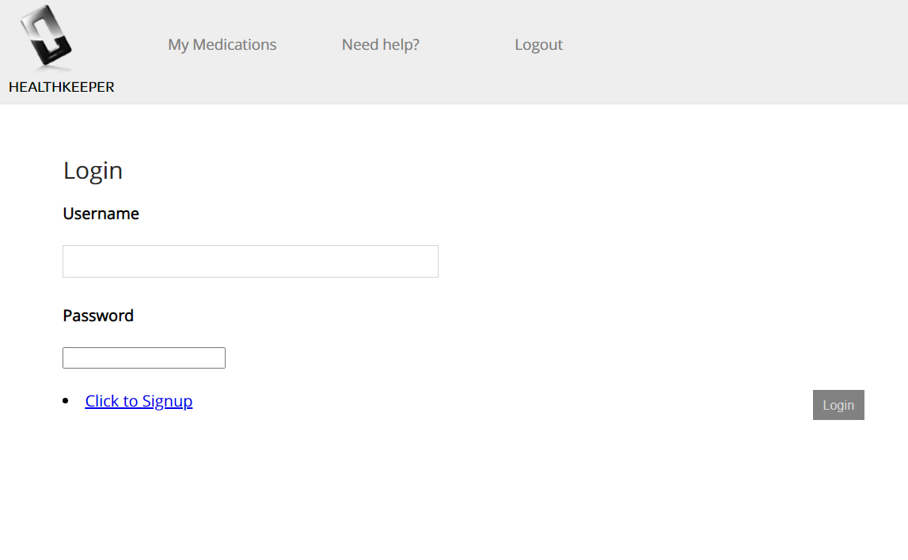
Login
This page includes a text field for both a username and password to be submitted to the server. It also gives the option to sign up for the service which navigates to the sign up page

Slide 5
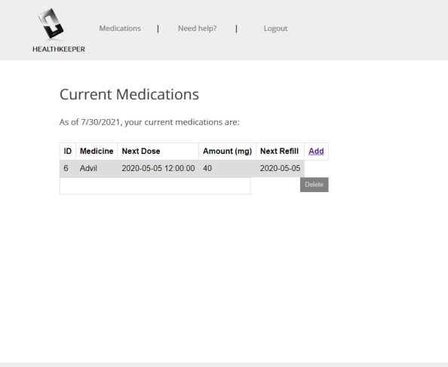
Current Medications
Current medications is the landing page after signing in. It will show you all of your medications that you are currently tracking aswell as giving you the option to add/delete any medicines.

Slide 6
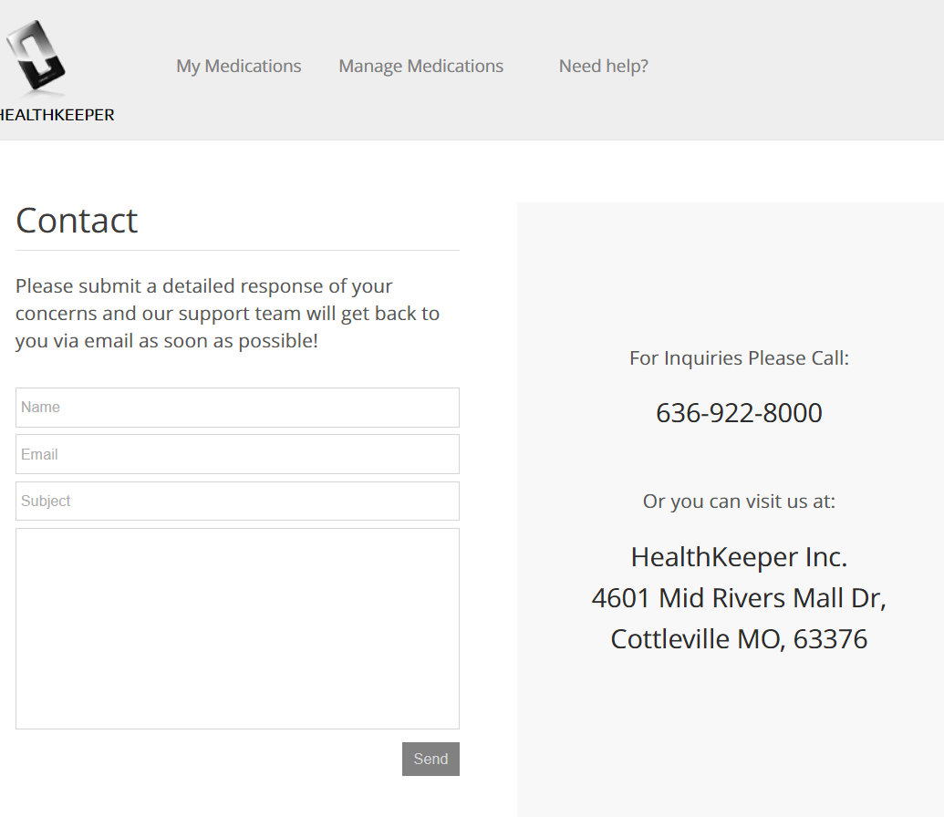
Help
The help page is a page to contact us with any issues that you are having with the service. You can enter your information and it will send the same way as an email to us. We would respond back to the email provided by the user.

